Slide 1
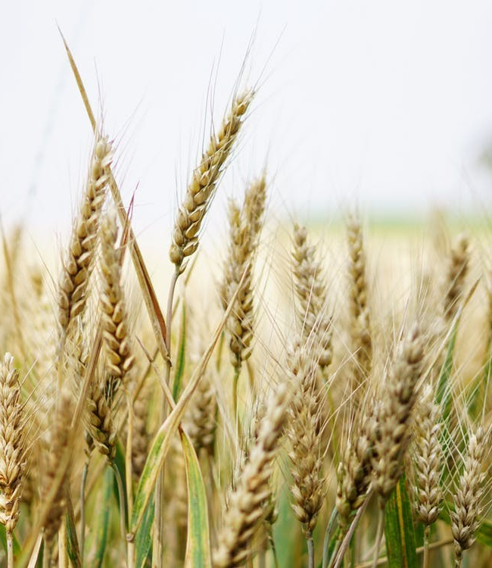
OUTCOME OF HARVEST SEASON
GUIDE-CHAYN PAUL SIR
180030396-S.JUHITHA
180031031-A.CHANDANA

Slide 2
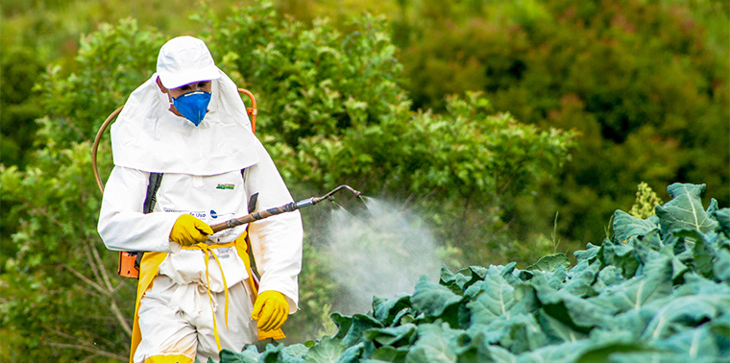
INTRODUCTION
Recently we have observed the emerging concept of smart farming that makes agriculture more efficient and effective with the help of high-precision algorithms.
Machine learning is everywhere throughout the whole growing and harvesting cycle. It begins with a seed being planted in the soil from the soil preparation, seeds breeding and water feed measurement.

Slide 3
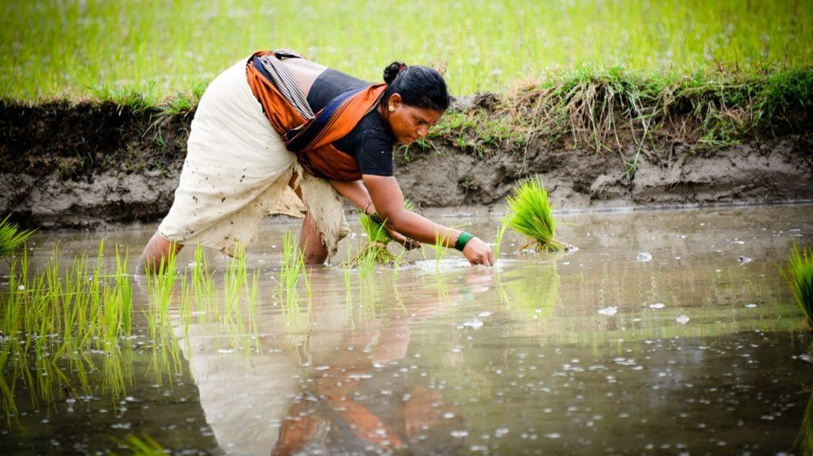
MOTIVATION
The Toxic Pesticides Though, many of us don't appreciate much, but a farmer's job is real test of endurance and determination.
A good harvest is ensured by several factors such as availability of water, soil fertility, protecting crops from rodents, timely use of pesticides & other useful chemicals and nature.
While a lot of these factors are difficult to control for, the amount and frequency of pesticides is something the farmer can control.

Slide 4

PROBLEM STATEMENT
Pesticides are special, because while they protect the crop with the right dosage. But, if you add more than required, they may spoil the entire harvest. This data is based on crops harvested by various farmers at the end of harvest season. To simplify the problem, we can assume that all other factors like variations in farming techniques have been controlled for.
Determining the outcome of the harvest season, i.e. whether the crop would be healthy (alive), damaged by pesticides or damaged by other reasons.

Slide 5
OBJECTIVE
Inspect the dataset and observe the various insights from the data.
Accordingly, I do the cleaning and pre-processing of the data .
Applying various algorithms on pre-processed data and compare the difference in accuracy and other factors.
To predict the harvest mutation would be alive or would be effected
by pesticides or die for some other reasons.

Slide 6
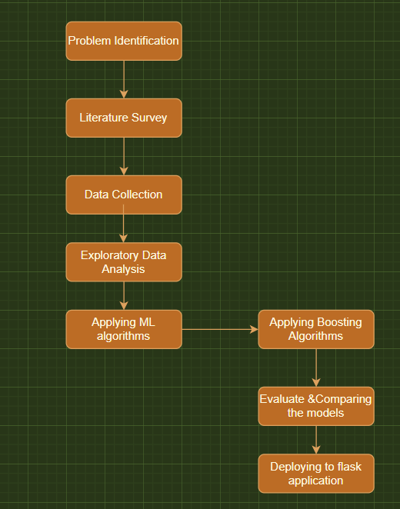
Work

Slide 7
METHODOLOGY
Step 1
Import train and test Dataset.
Step 2
Import required libraries.
Numpy
Pandas
Matplotlib
Seaborn
Step 3
Checking for unique and null values
Step 4
Filling null values with mean of data.
Step 5
Finding the outlier and changing their values with mean of data
Step 6
Data visualization

Slide 8
METHODOLOGY
Training the model with different classifiers
Random forest classifier
K-nearest neighbors classifier
Decision tree classifier
Training the model with gradient boosting algorithms
AdaBoost
Lightgbm
Xgboost

Slide 9
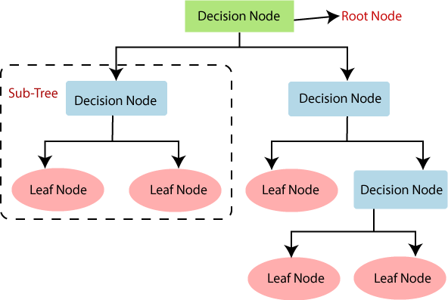
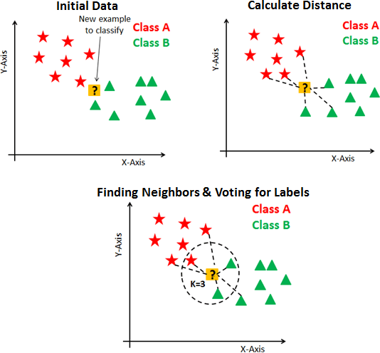
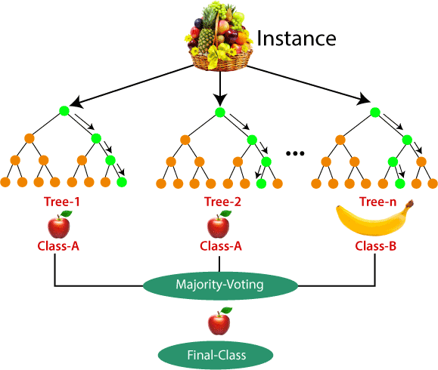
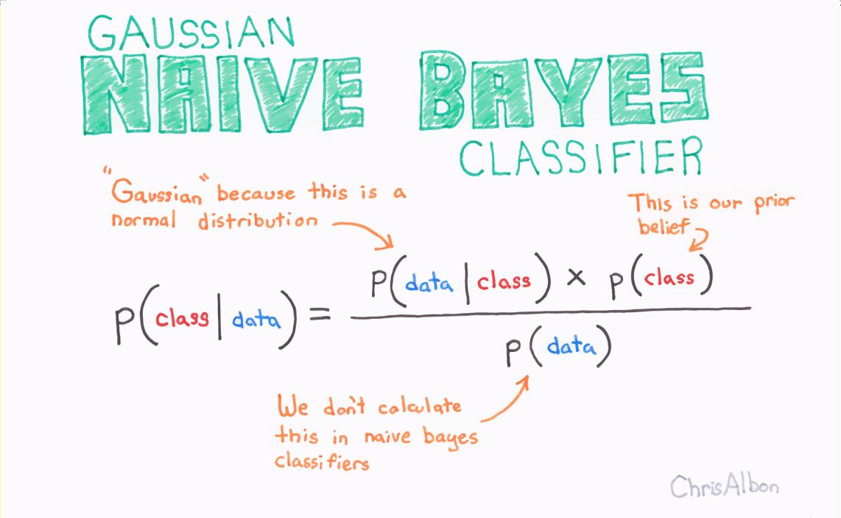
THANK YOU
Decision Tree
K-Nearest Neighbours
Random forest classifier

Slide 10
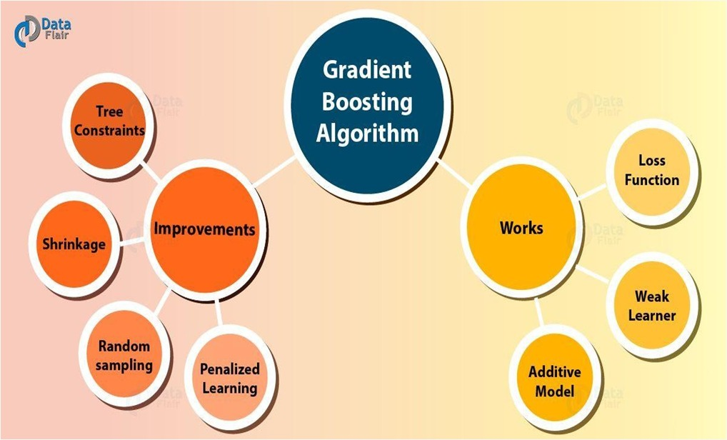

Slide 11
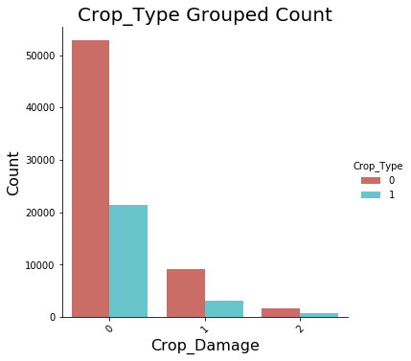
RESULT

Slide 12
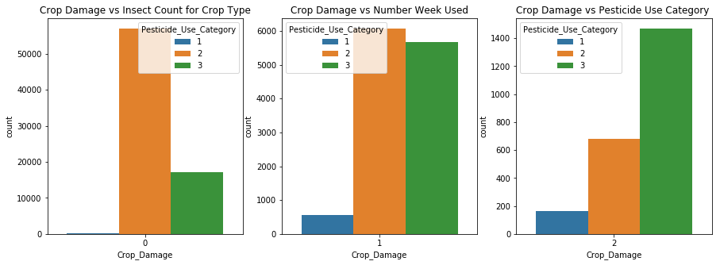
RESULT

Slide 13
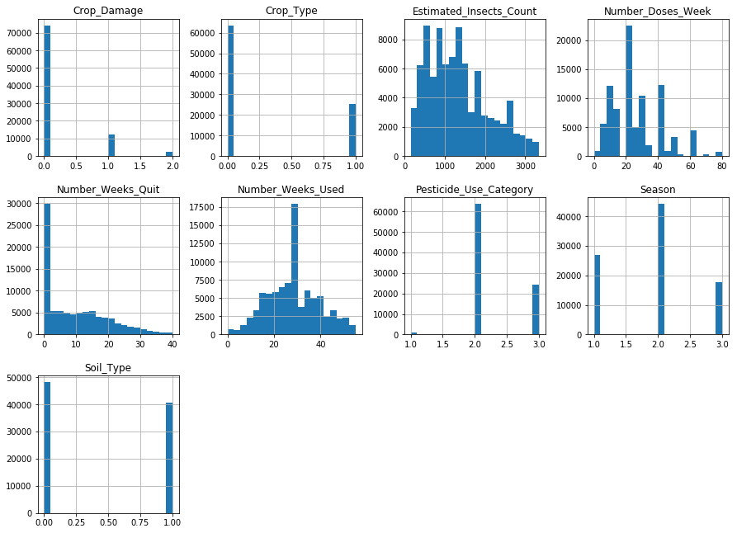
RESULT

Slide 14
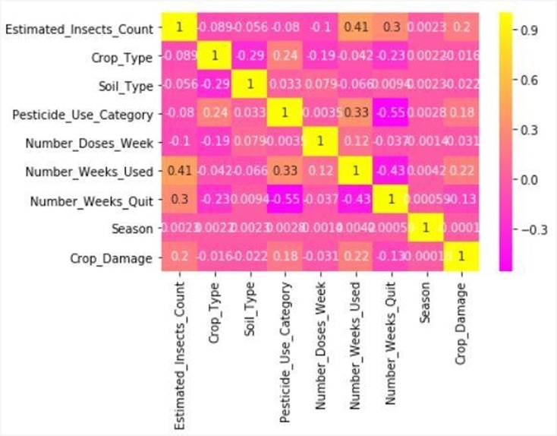

Slide 15
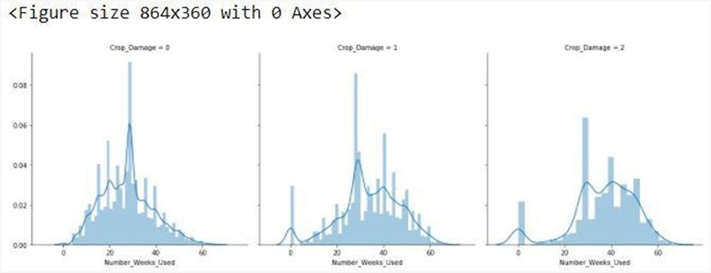
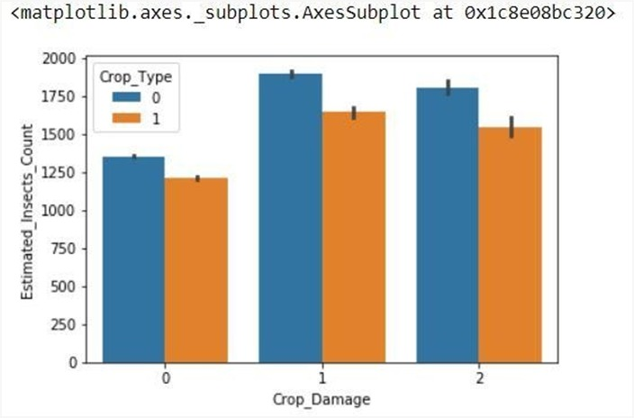

Slide 16
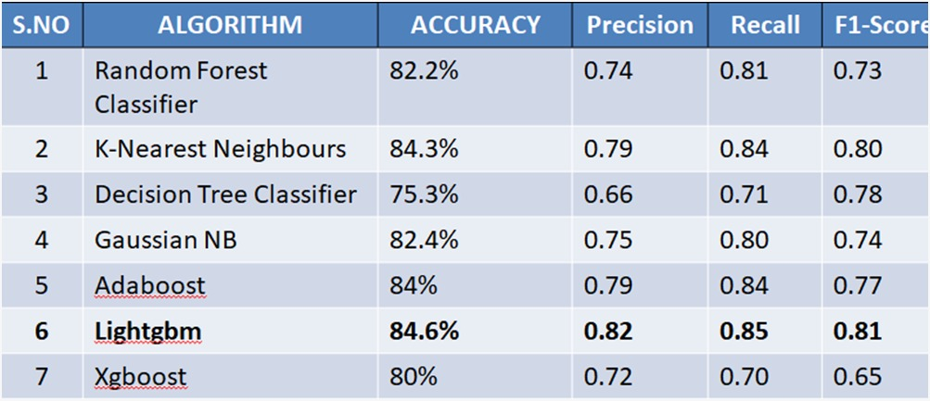
Final result

Slide 17
Conclusion
Outcome of harvest season is all about predicting the outcome or status of the crop plantation at the end of harvest season. This would give an idea for the farmers that how much amount of pesticides he has to use and can also take care of the insects in his field so that he can increase efficiency of the harvest crop to be healthy. I have the dataset with 8-independent and 1- dependent variable. Here, in the dependent variable I have 3 class labels where 0 - Crop is alive, 1– Damaged by pesticides. 2 – Damaged by some other reason.By doing data inspection, exploratory data analysis and model building, I got a final accuracy of 84.6% .

Slide 18
REFERENCE
https://lightgbm.readthedocs.io/en/latest/pythonapi/lightgbm. LGBMClassifier.html
https://machinelearningmastery.com/boosting-and-adaboost- for-machine-learning/
https://scikit- learn.org/stable/modules/generated/sklearn.naive_bayes.Gaus sianNB.html
https://scikit- learn.org/stable/modules/generated/sklearn.ensemble.Rando mForestClassifier.html
https://xgboost.readthedocs.io/en/latest/

Slide 19
THANK YOU

